Slide 1

Tree基本概念

Slide 2
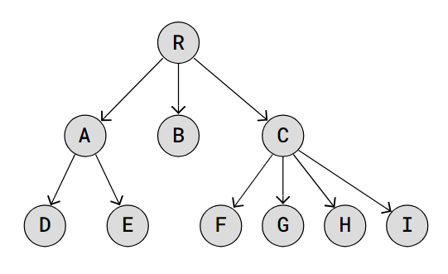
1.Tree
The Tree data structure is similar to Linked Lists in that each node contains data and can be linked to other nodes.
Notes:
What is Tree | Tree Definition & Meaning in DSA – GeeksforGeeks

Slide 3
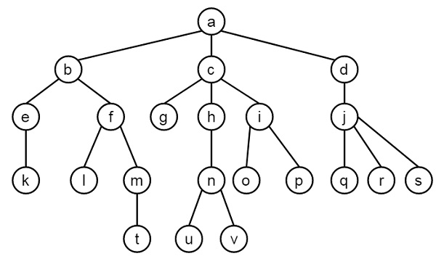
1.2 Tree Terminology and Rules
Root、Leaf、Node、Subtree
Parent、 Child、Sibling、Ancestor、Descendant
Degree、 Edge
Height、Depth、Level

Slide 4
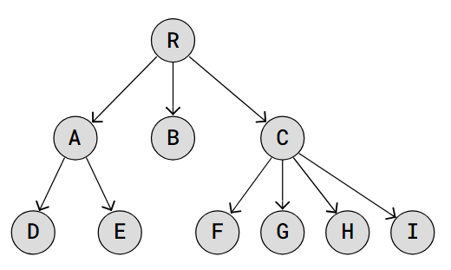
1.2 Tree Terminology and Rules
The first node in a tree is called the root node.
A link connecting one node to another is called an edge.
A parent node has links to its child nodes. Another word for a parent node is internal node.
A node can have zero, one, or many child nodes.
A node can only have one parent node.
Nodes without links to other child nodes are called leaves, or leaf nodes.
The tree height is the maximum number of edges from the root node to a leaf node. The height of the tree above is 2.
The height of a node is the maximum number of edges between the node and a leaf node.
The tree size is the number of nodes in the tree.
Notes:
DSA Trees (w3schools.com)

Slide 5
1.3 Types of Trees
Trees are a fundamental data structure in computer science, used to represent hierarchical relationships. This tutorial covers several key types of trees.
General Trees:
Binary Trees: Each node has up to two children, the left child node and the right child node. This structure is the foundation for more complex tree types like Binay Search Trees and AVL Trees.
Notes:
Binary Search Trees (BSTs): A type of Binary Tree where for each node, the left child node has a lower value, and the right child node has a higher value.
AVL Trees: A type of Binary Search Tree that self-balances so that for every node, the difference in height between the left and right subtrees is at most one. This balance is maintained through rotations when nodes are inserted or deleted.

Slide 6
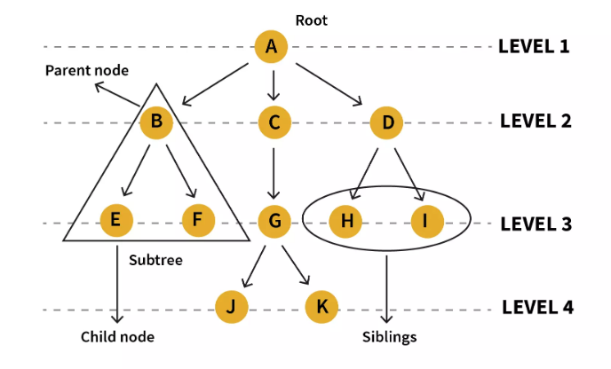

Slide 7
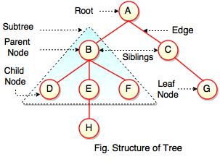

Slide 8
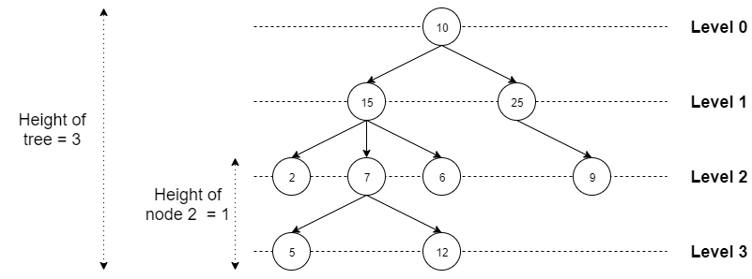

Slide 9
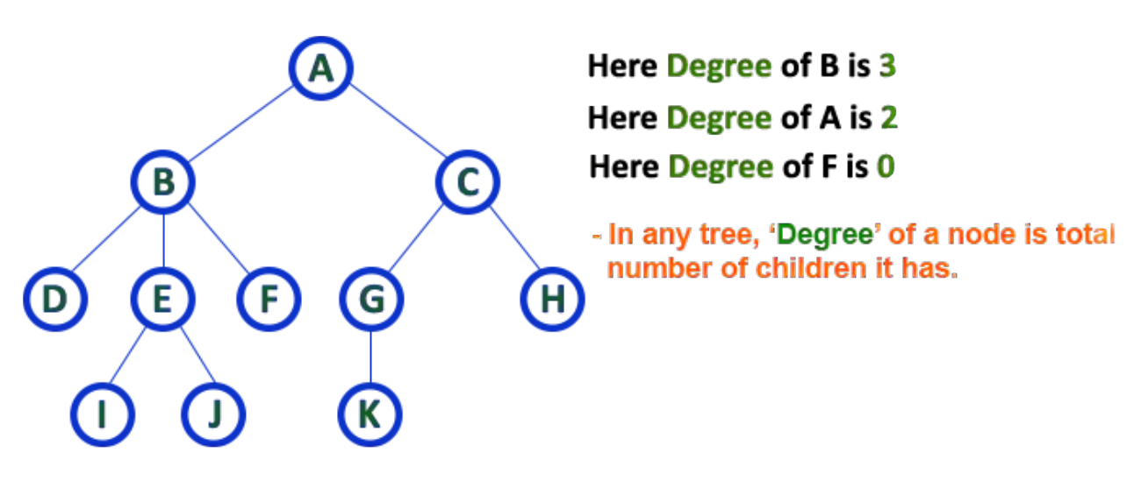

Slide 10
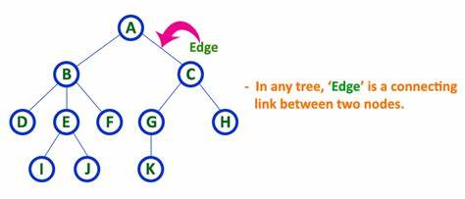

Slide 11
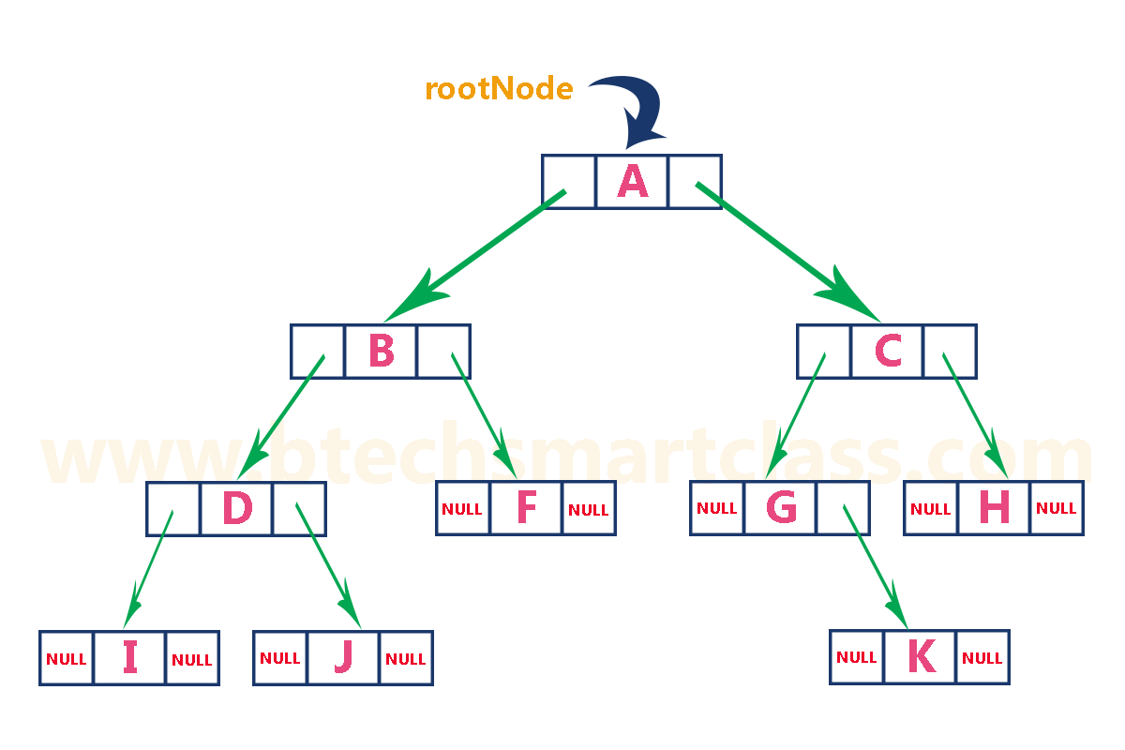

Slide 12
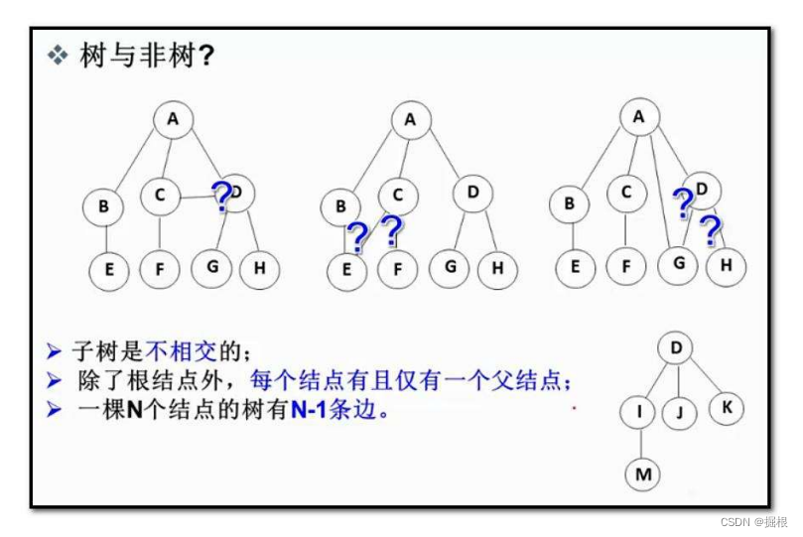

Slide 13
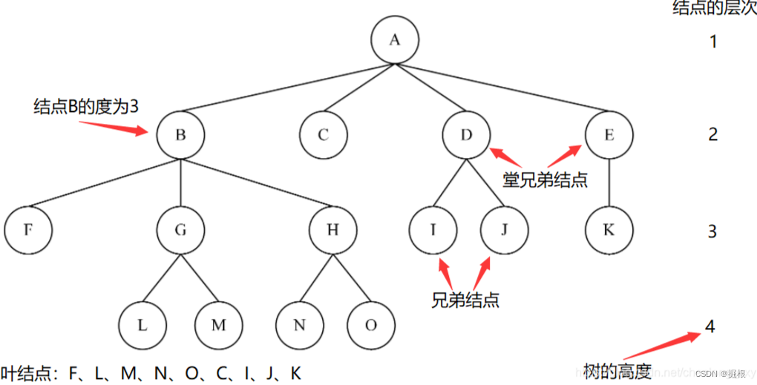

Slide 14
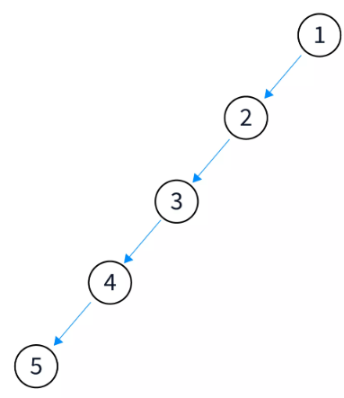
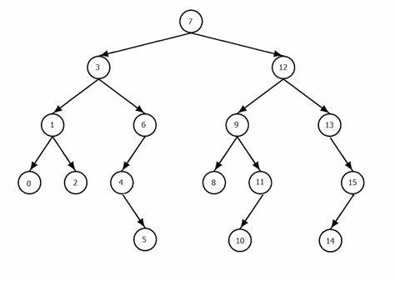
2. Binary Trees
each node can have a maximum of two child nodes; a left child node and a right child node.
Notes:
Skewed：被扭曲的；歪斜的

Slide 15
2.1 Types of Binary Trees
Here are a few common binary tree types:
Full Binary Tree: Every node has either 0 or 2 child nodes, i.e., left and right or no children
Complete Binary Tree: All levels, except possibly the last, are filled, and all nodes are as left as possible
Perfect Binary Tree: All nodes have exactly two children, and all leaf nodes are at the same level
Binary Search Tree (BST): A binary tree in which the left child node is smaller, and the right child node is greater than the parent node
Balanced Binary Tree: The heights of any node’s left and right subtrees differ by at most one

Slide 16
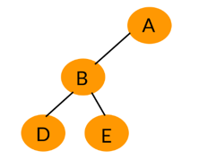
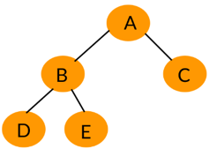
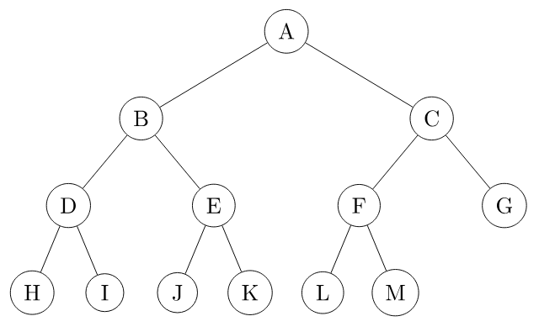
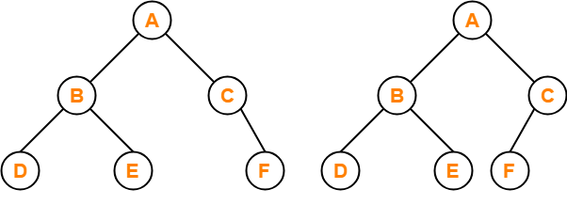
1.1 Full Binary Tree
Every node has either 0 or 2 child nodes
？
？
Full Binary Tree
？
？

Slide 17
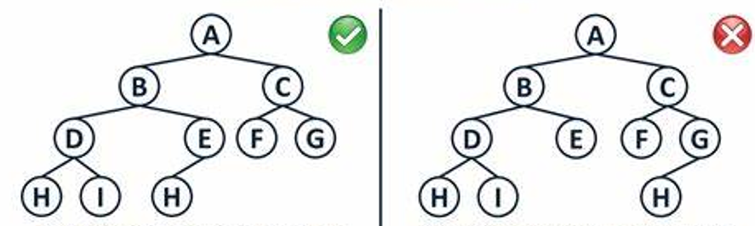
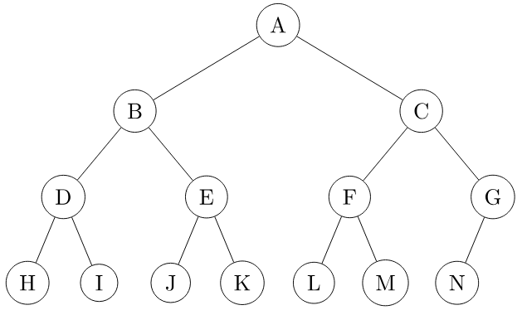
1.2 Complete Binary Tree
all levels are filled except the lowest level nodes, which are filled from the left:
？
？
？
？

Slide 18
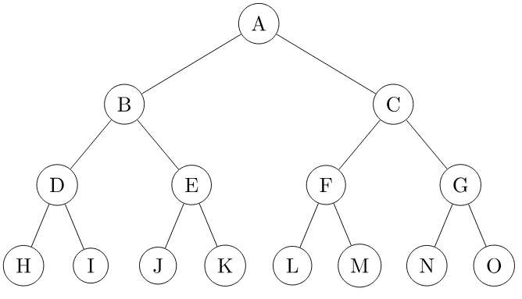
1.3 Perfect Binary Tree
All nodes have exactly two children, and all leaf nodes are at the same level
？
？
？
？

Slide 19
Properties of a Perfect Binary Tree: 2024-09-23
Degree: The degree of a node of a tree is defined as the number of children of that node. All the internal nodes have a degree of 2. The leaf nodes of a perfect binary tree have a degree of 0. 度： 除叶节点外，其它节点度都是 2
Number of leaf nodes: If the height of the perfect binary tree is h, then the number of leaf nodes will be 2^{h} because the last level is completely filled. 叶节点数量：若数高度为 h, 叶节点数量一定为 2^{h}
Total number of nodes: A tree of height h has total nodes = 2^{h+1} – 1. Each node of the tree is filled. So total number of nodes can be calculated as 2⁰ + 2¹ + . . . + 2^{h} = 2^{h+1} – 1. 高度为 h 节点总数为 2^{h+1} – 1
Height of the tree: The height of a perfect binary tree with N number of nodes = log(N + 1) – 1 = Θ(ln(n)). This can be calculated using the relation shown while calculating the total number of nodes in a perfect binary tree.
节点总数为N, 则，高度= log(N + 1) – 1

Slide 20
Check whether a tree is a Perfect Binary Tree or not:
Check the depth of the tree. A perfect binary tree is defined as a tree where all leaf nodes are at the same depth, and all non-leaf nodes have two children. To check whether a tree is a perfect binary tree, you can first calculate the depth of the tree.
Check the number of nodes at each level: Once you have calculated the depth of the tree, you can then check the number of nodes at each level. In a perfect binary tree, the number of nodes at each level should be a power of 2 (e.g. 1, 2, 4, 8, etc.). If any level has a different number of nodes, the tree is not a perfect binary tree.
// An empty tree is perfect
// If leaf node, then its depth must be same as depth of all other leaves.
// If internal node and one child is empty
// Left and right subtrees must be perfect.
Notes:
Perfect Binary Tree - GeeksforGeeks

Slide 21
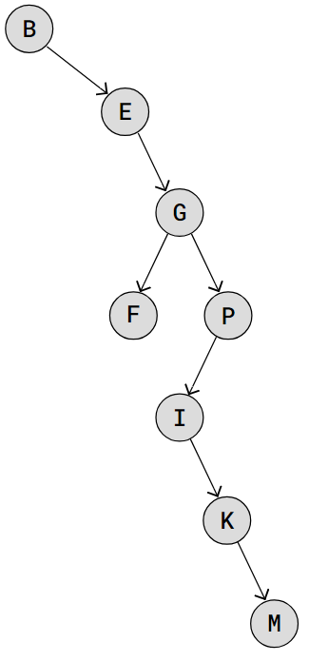
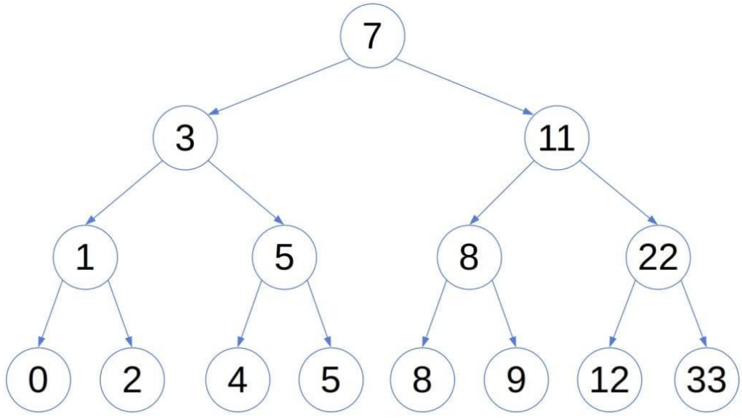
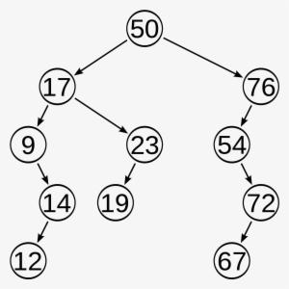
1.4 Binary Search Tree
The X node's left child and all of its descendants (sub-tree) have lower values than X's value.
The right child, and all its descendants have higher/same values than X's value.
Left and right subtrees must also be Binary Search Trees.
？
？
Notes:
DSA Binary Search Trees (w3schools.com)

Slide 22
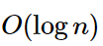
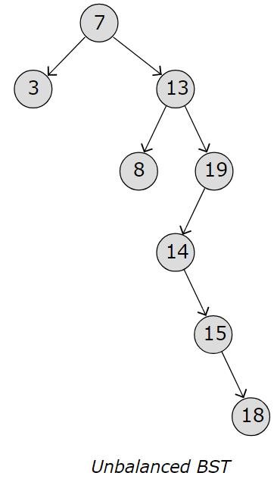
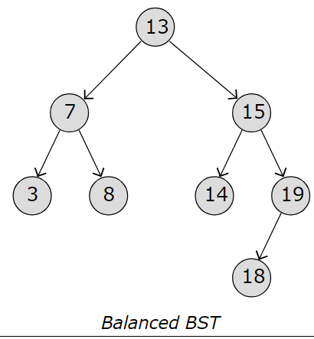
1.4 Binary Search Tree - Time Complexity
On a Binary Search Tree, operations like inserting a new node, deleting a node, or searching for a node are actually O(h). That means that the higher the tree is h, the longer the operation will take.
The reason why we wrote that searching for a value is O(log ⁡n) in the table above is because that is true if the tree is "balanced", like in the image below.
Notes:
DSA Binary Search Trees (w3schools.com)

Slide 23
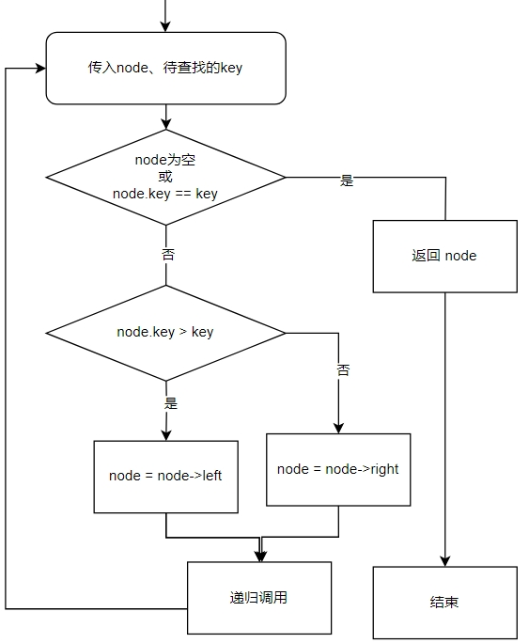
查找算法
First, compare the element to be searched with the root element of the tree.
If root is matched with the target element, then return the node’s location.
If it is not matched, then check whether the item is less than the root element, if it is smaller than the root element, then move to the left subtree.
If it is larger than the root element, then move to the right subtree.
Repeat the above procedure recursively until the match is found.
If the element is not found or not present in the tree, then return NULL.

Slide 24
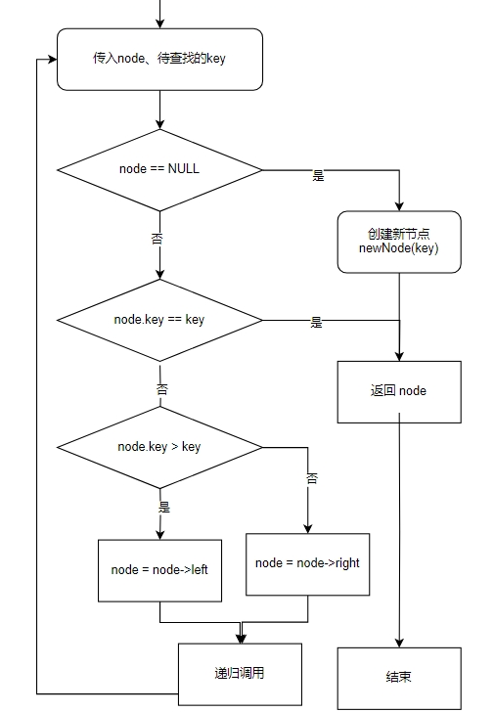
插入算法
A new key is always inserted at the leaf. Start searching a key from the root till a leaf node. Once a leaf node is found, the new node is added as a child of the leaf node.
肯定是插入到叶节点下面；所以：
找到叶节点值相同的，返回当前节点
没找到，加入最后那个节点的 子节点（比当前节点小，加成左节点，否则，为右节点。

Slide 25
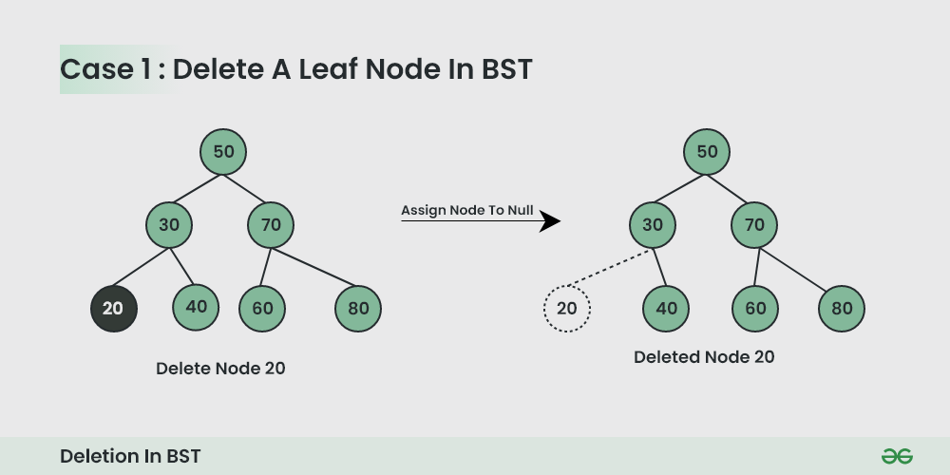
删除节点Delete a Node of BST
Different scenarios for deleting the node:
Node to be deleted is the leaf node: Its simple you can just null it out
Node to be deleted has one child: You can just replace the node with the child node
Notes:
Introduction to Binary Search Tree – GeeksforGeeks

Slide 26
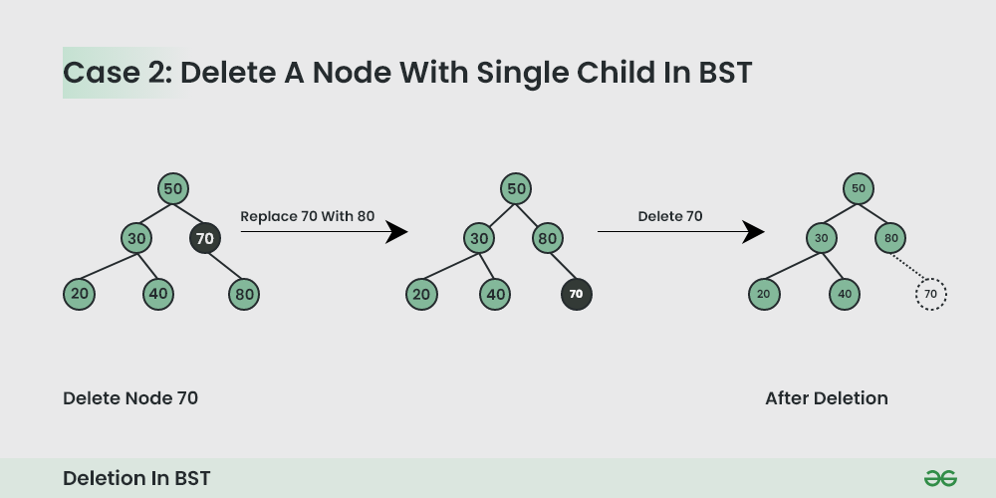
删除节点Delete a Node of BST
2. Node to be deleted has one child :
You can just replace the node with the child node.

Slide 27
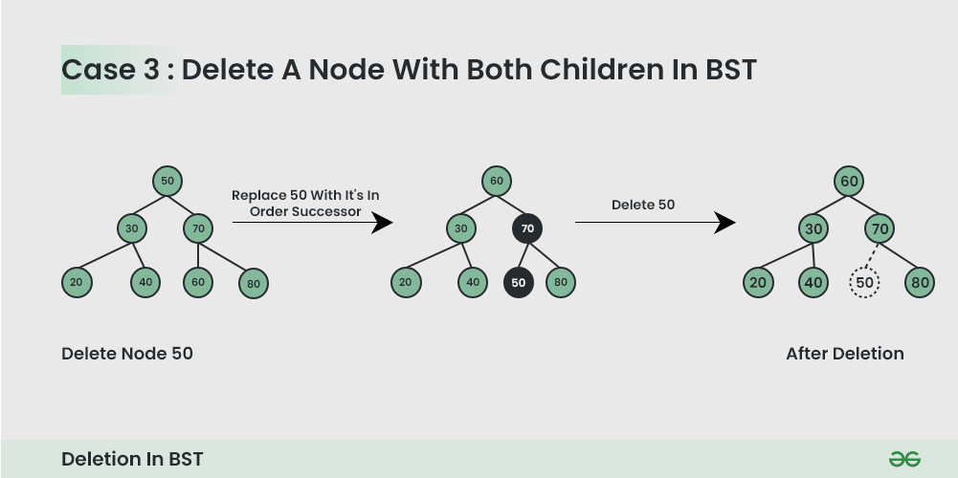
删除节点Delete a Node of BST
2. Node to be deleted has two children :
Here we have to delete the node is such a way, that the resulting tree follows the properties of a BST. 删除后确保还是一棵BST.
The trick is to find the inorder successor of the node. Copy contents of the inorder successor to the node, and delete the inorder successor.
.
Notes:
Trick: 技巧

Slide 28
Balance a Binary Search Tree

Slide 29
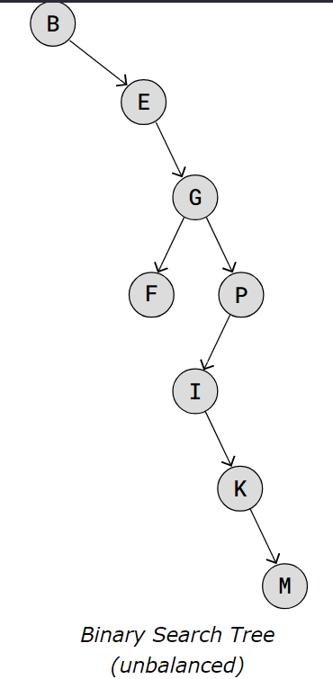
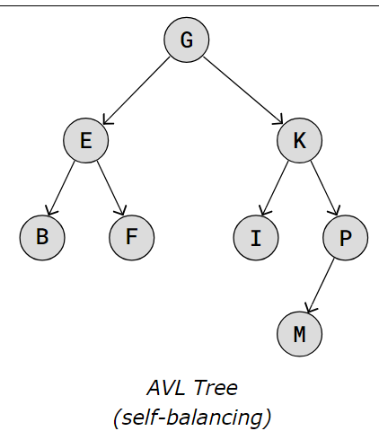
1.5 Balanced Binary Tree -AVL Trees
In an AVL tree, we call a node balanced if the heights of its left and right sub-trees differ at most by 1. So, a search tree with root x is an AVL tree if all its nodes are balanced in the AVL sense (empty search trees, with height 0, are trivially balanced):
Notes:
Balanced Trees | Baeldung on Computer Science
DSA AVL Trees (w3schools.com)

Slide 30
1.5 AVL Trees - Time Complexity
Binary Search Trees take the best from two other data structures: Arrays and Linked Lists.
Searching a BST is just as fast as Binary Search on an array, with the same time complexity O(logn)O(log⁡n).
And deleting and inserting new values can be done without shifting elements in memory, just like with Linked Lists.
Data Structure | Searching for a value | Delete / Insert leads to shifting in memory
Sorted Array | O(logn)O(log⁡n) | Yes
Linked List | O(n)O(n) | No
Binary Search Tree | O(logn)O(log⁡n) | No

Slide 31
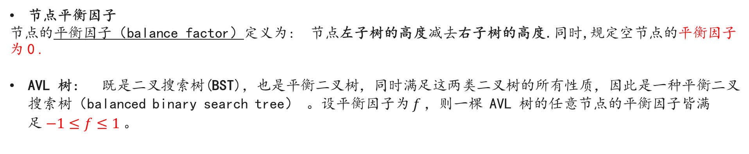
AVL树
7.5.1 AVL 树常见术语
节点平衡因子
节点的平衡因子（balance factor）定义为: 节点左子树的高度减去右子树的高度.同时,规定空节点的平衡因子为 0 .
AVL 树: 既是二叉搜索树(BST)，也是平衡二叉树，同时满足这两类二叉树的所有性质，因此是一种平衡二叉搜索树（balanced binary search tree） 。设平衡因子为 $f$，则一棵 AVL 树的任意节点的平衡因子皆满足 $−1≤f≤1$。

Slide 32
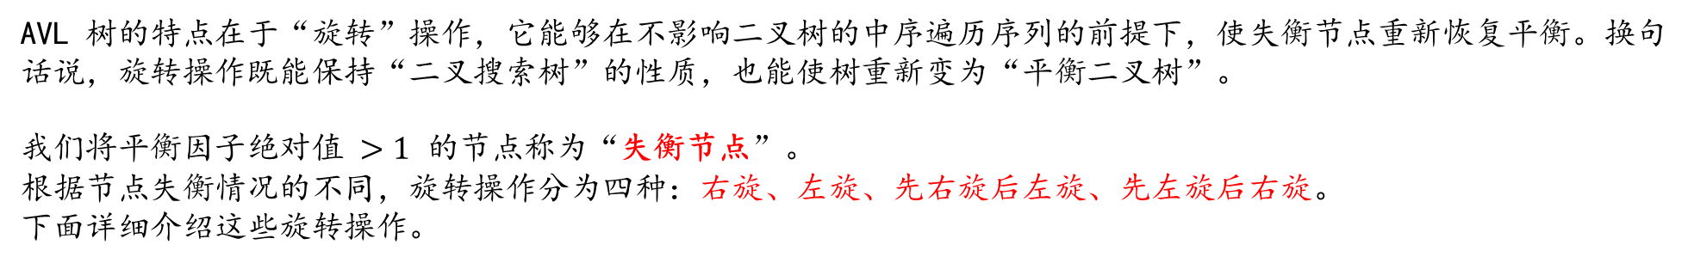
7.5.2 AVL 树旋转
AVL 树的特点在于“旋转”操作，它能够在不影响二叉树的中序遍历序列的前提下，使失衡节点重新恢复平衡。换句话说，旋转操作既能保持“二叉搜索树”的性质，也能使树重新变为“平衡二叉树”。
我们将平衡因子绝对值 $>1$ 的节点称为“失衡节点”。 根据节点失衡情况的不同，旋转操作分为四种：右旋、左旋、先右旋后左旋、先左旋后右旋。
下面详细介绍这些旋转操作。
7.5 AVL 树 * - Hello 算法 (hello-algo.com)
Notes:
7.5 AVL 树 * - Hello 算法 (hello-algo.com)

Slide 33
AVL Tree Data Structure
An AVL tree defined as a self-balancing Binary Search Tree (BST) where the difference between heights of left and right subtrees for any node cannot be more than one.
The difference between the heights of the left subtree and the right subtree for any node is known as the balance factor of the node.
AVL which is, the heights differences of BST between the heights of left and right subtrees for every node are less than or equal to 1.
Notes:
Insertion in an AVL Tree - GeeksforGeeks

Slide 34
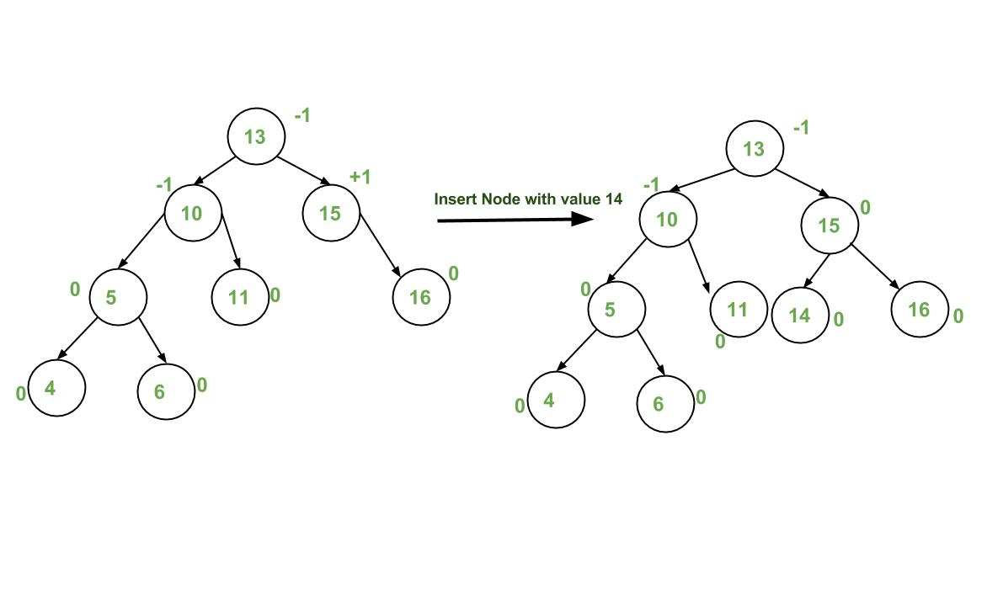










Steps to follow for insertion:

Slide 35
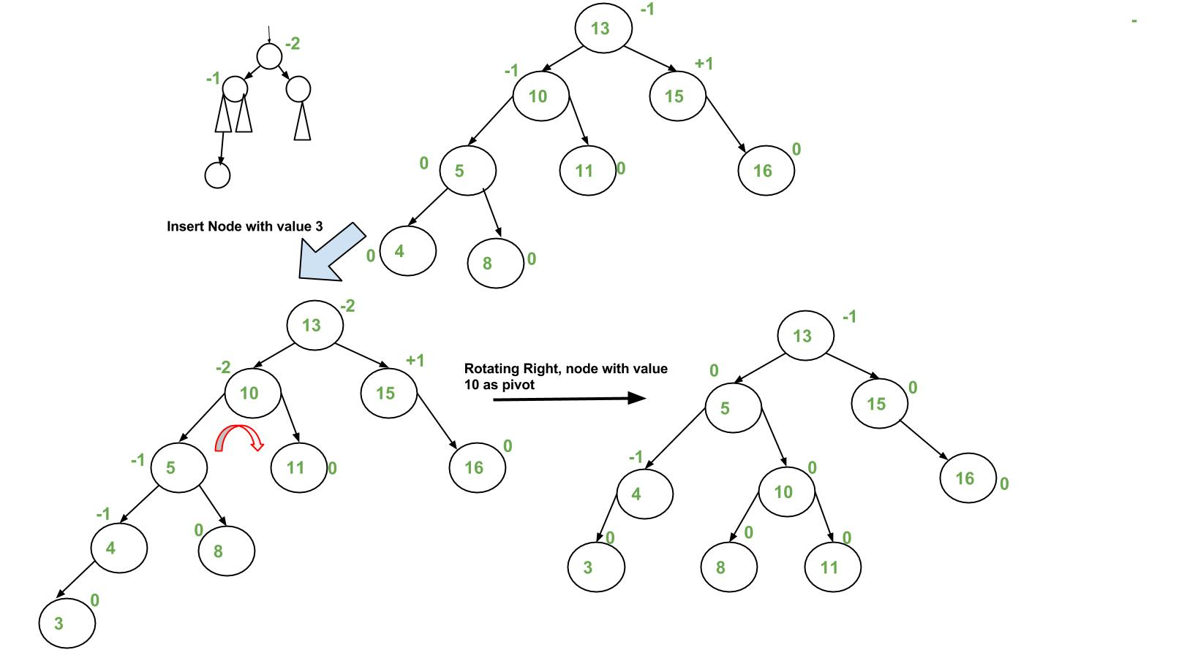

Slide 36
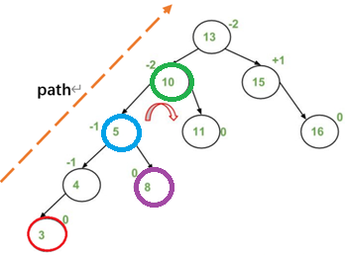

Slide 37
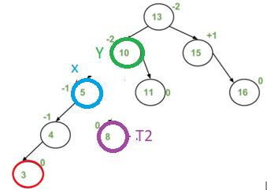
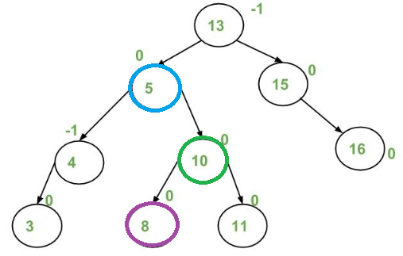

Slide 39
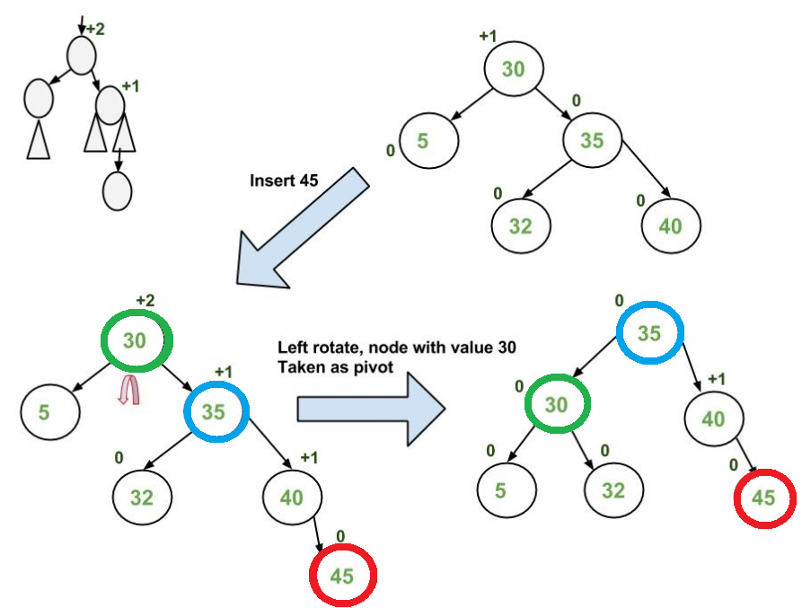

Slide 40
Follow the steps mentioned below to implement the idea:
Follow the steps mentioned below to implement the idea:
Perform the normal BST insertion. 执行一个BST的插入算法
The current node must be one of the ancestors of the newly inserted node. Update the height of the current node. 当前节点必须是刚插入节点的祖先
Get the balance factor (left subtree height – right subtree height) of the current node.获取当前节点的平衡因子
If the balance factor is greater than 1, then the current node is unbalanced and we are either in the Left Left case or left Right case.
check whether it is left left case or not, compare the newly inserted key with the key in the left subtree root. 新节点key 和左子树根节点的key
If the balance factor is less than -1, then the current node is unbalanced and we are either in the Right Right case or Right-Left case. To check whether it is the Right Right case or not, compare the newly inserted key with the key in the right subtree root.

Slide 41
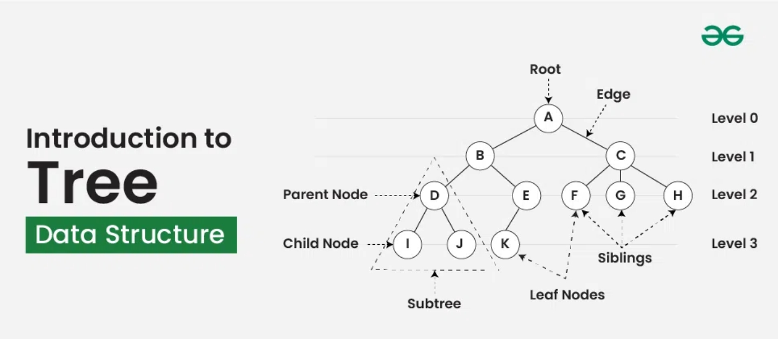
Introduction to Tree Data Structure

Slide 42
Basic Terminologies In Tree Data Structure:
Parent Node: The node which is a predecessor of a node is called the parent node of that node. {B} is the parent node of {D, E}.
Child Node: The node which is the immediate successor of a node is called the child node of that node. Examples: {D, E} are the child nodes of {B}.
Root Node: The topmost node of a tree or the node which does not have any parent node is called the root node. {A} is the root node of the tree. A non-empty tree must contain exactly one root node and exactly one path from the root to all other nodes of the tree.
Leaf Node or External Node: The nodes which do not have any child nodes are called leaf nodes. {I, J, K, F, G, H} are the leaf nodes of the tree.
Ancestor of a Node: Any predecessor nodes on the path of the root to that node are called Ancestors of that node. {A,B} are the ancestor nodes of the node {E}
Descendant: A node x is a descendant of another node y if and only if y is an ancestor of x.
Sibling: Children of the same parent node are called siblings. {D,E} are called siblings.
Level of a node: The count of edges on the path from the root node to that node. The root node has level 0.
Internal node: A node with at least one child is called Internal Node.
Neighbour of a Node: Parent or child nodes of that node are called neighbors of that node.
Subtree: Any node of the tree along with its descendant.

Slide 43
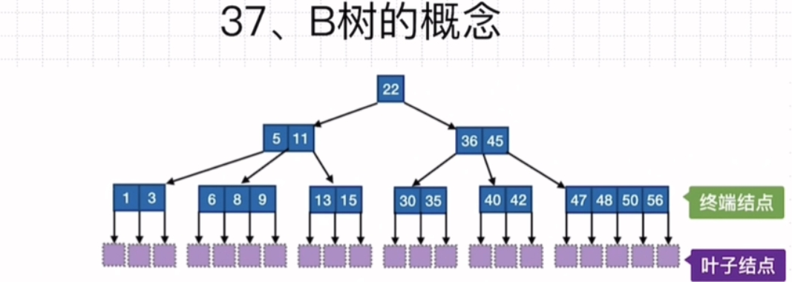

Slide 44
B-Tree概念
B树是一种平衡的多路查找树：
平衡：在一棵B树中，每个结点的任意两个子树的高度之差的绝对值（平衡因子）为 0 。结果就是在一棵B树中，所有的叶结点都在同一层。
多路：路数指的是树中结点的分叉数，比如二叉树就是二路树，B树是一棵多叉树，在B树中路数也称阶数。
查找：对二叉搜索树进行二叉树的中序遍历输出所有关键字的序列是单调递增序列。对B树进行“中序遍历”输出所有关键字的序列是单调递增序列。

Slide 45
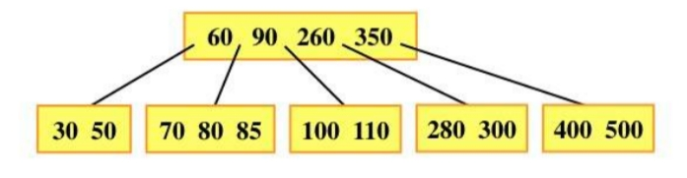
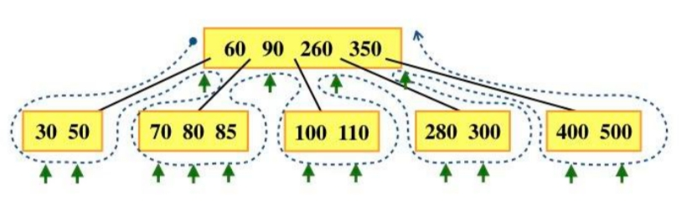
B-Tree概念
为了方便，我们采用环线法对B树进行“中序遍历”，得到一个单调递增序列。
深入理解
B树实际上是树和顺序表的结合体，总体结构一棵树，每个结点是一个顺序表，其“中序遍历”序列也是一个顺序表，B树兼具了树和顺序表的优点。

Slide 46
B-Tree概念
深入理解
B树实际上是树和顺序表的结合体，总体结构一棵树，每个结点是一个顺序表，其“中序遍历”序列也是一个顺序表，B树兼具了树和顺序表的优点。

Slide 47
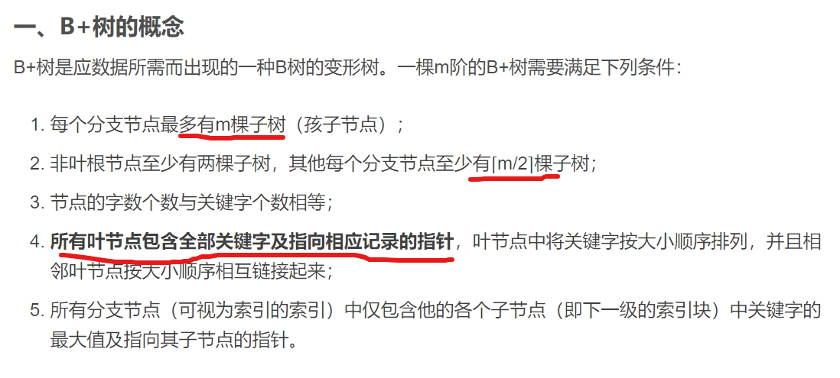
B+

Slide 48
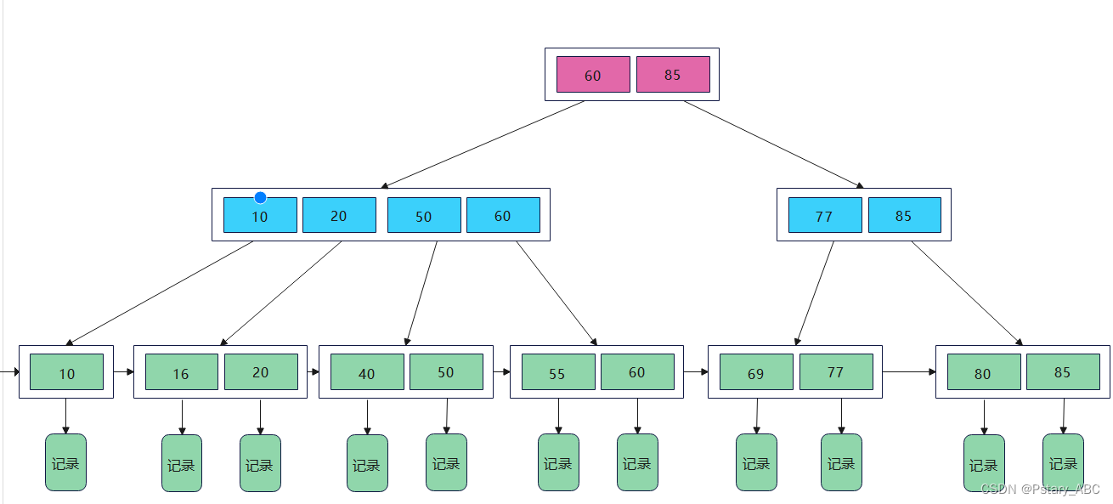
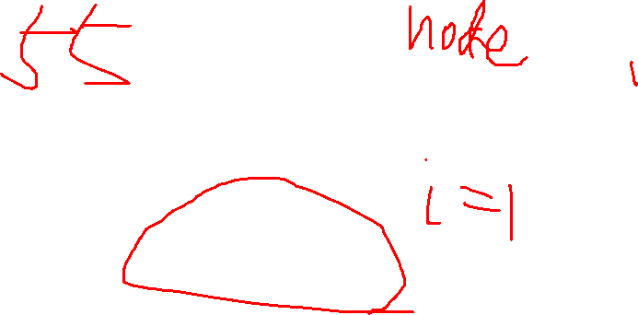
76

Slide 49
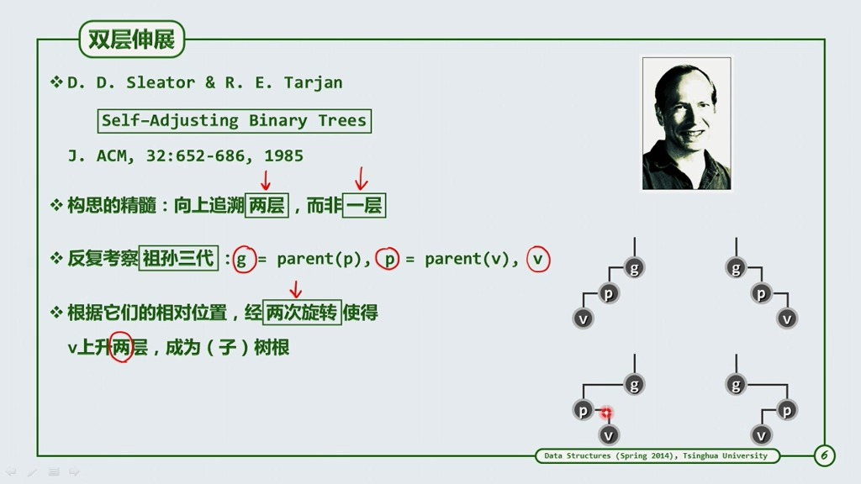

Slide 50
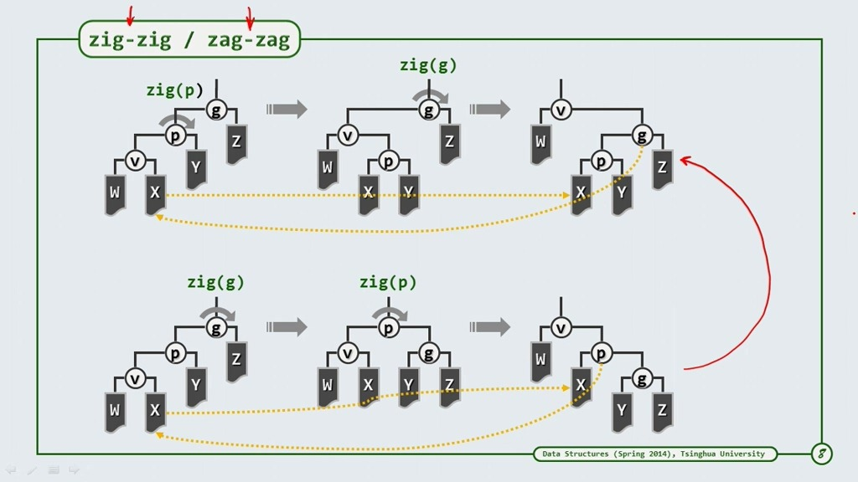
Notes:
高级搜索——伸展树Splay详解_splay tree-CSDN博客

